Slide 1

INTRODUCTION
Name :- Latish Rajendra Suryawanshi
Project Topic :- Book Recommendation System
Mentor :- Ashwini Kakade Madam
Batch :- ML 09

Slide 2
PROJECT CONTENTS :-
What is Book Recommendation System?
2.Real Life Applications?
3.Libraries?
4.Flow Chart?
5.Dataset Details?
6.Reference?
7.Conclusion?

Slide 3

WHAT IS BOOK RECOMMENDATION SYSTEM :-
A book recommendation system is a type of recommendation system where we have to recommend similar books to the reader based on his interest. We can say that a recommendation system is a tool designed to predict/filter the items as per the user’s behaviour.

Slide 4



REAL LIFE APPLICATIONS :-
Google Play Books
Amazon Kindle
Wattpad

Slide 5

LIBRARIES :-
import numpy as np
2) import pandas as pd
3) from sklearn.metrics.pariwise import cosine_similarity

Slide 6
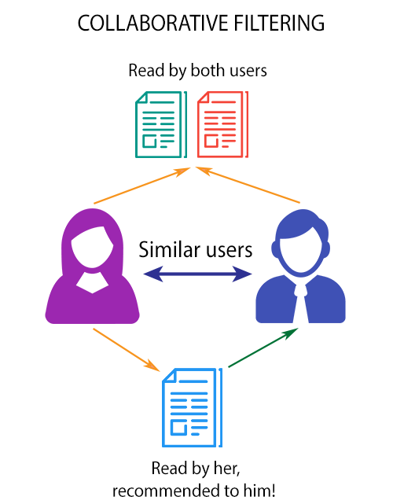
FLOW CHART :-

Slide 7
DATASET DETAILS & REFERENCE :-
In my book recommendation system i am using three data sets this data sets available on Kaggle.com. 1.books.csv 2.users.csv 3.ratings.csv
books.csv :- Book-Title, Book-Author, Year-Of-Publication, Publisher, ISBN are the attribute are contain in dataset.
users.csv :- User-ID, Location, Age are the attribute are contain in dataset.
ratings.csv :- User-ID, ISBN, Book-Rating are the attribute are contain in dataset.

Slide 8

CONCLUSION :-
In conclusion, creating a book recommendation system with machine learning imporves user experience. It offers personalized book suggestions based on individual preferences.
The recommendation system analyses the past preferences of the user concerned, and then it uses this information to try to find similar books.

